Slide 1
Pipelining
Dr. Javier Navaridas
javier.navaridas@manchester.ac.uk
COMP25212 System Architecture

Slide 2
From Tuesday…
What is pipelining?
  Dividing execution logic into stages and storing state between stages so that different instructions can be at different stages of processing
What are its benefits?
  Pipelining improves the performance by allowing to increase the frequency and enables better logic utilization as all stages will do useful work

Slide 3
From Tuesday …
What is a Control Hazard?
  When a branch is executed in a pipeline, the CPU does not know it is a branch until the ID stage. By that time other instructions had been fetched and need to be removed or marked as useless to avoid unexpected changes to the state. This slows processing down
How can we mitigate Control Hazards’ negative effects?
  There are many Branch prediction techniques that can be used to predict when a branch will be fetched and its target. If prediction is right, then no cycle is wasted

Slide 4
Data Hazards

Slide 5
Data Hazards
Pipeline can cause other problems
Consider
    ADD R1,R2,R3
    MUL R0,R1,R1
The ADD produces a value in R1
The MUL uses R1 as input
There is a data dependency between them
R2 R3
ADD
R1
MUL
R0

Slide 6
Instructions in the Pipeline
IF ID EX MEM WB
MUL R0,R1,R1
ADD R1,R2,R3
Register Bank
Data
Cache
PC
Instruction
Cache
ALU
MUX
The new value of R1 has not been updated in the register bank
MUL would be reading an outdated value!!

Slide 7
The Data is not Ready
At the end of the ID cycle, MUL instruction should have selected value in R1 to put into buffer at input to EX stage
But the correct value for R1 from ADD instruction is being put into the buffer at the output of EX stage at this time
It will not get to the input of WB until one cycle later – then probably another cycle to write into register bank

Slide 8
Dealing with data dependencies (I)
Detect dependencies in HW and hold instructions in ID stage until data is ready, i.e. pipeline stall
  Bubbles and wasted cycles again
 | Clock Cycle
 | 1 | 2 | 3 | 4 | 5 | 6 | 7 | 8
ADD R1,R2,R3 | IF | ID | EX | MEM | WB
MUL R0,R1,R1 |  | IF | ID | - | - | EX | MEM | WB
_{data is produced here}
_{R1 is written back here}
_{MUL can read R1 safely here}

Slide 9
Dealing with data dependencies (II)
Use the compiler to try and reorder instructions
  Only works if we can find something useful to do – otherwise insert NOPs – waste
 | Clock Cycle
 | 1 | 2 | 3 | 4 | 5 | 6 | 7 | 8
ADD R1,R2,R3 | IF | ID | EX | MEM | WB
Instr A / NOP |  | IF | ID | EX | MEM | WB
Instr B / NOP |  |  | IF | ID | EX | MEM | WB
MUL R0,R1,R1 |  |  |  | IF | ID | EX | MEM | WB

Slide 10
Dealing with data dependencies (III)
We can add extra data paths for specific cases
  The output of EX feeds back into the input of EX
  Sends the data to next instruction
Control becomes more complex
MUL R0,R1,R1
ADD R1,R2,R3
Register Bank
Data
Cache
PC
Instruction
Cache
ALU
MUX
_{Result}
_{From ADD}

Slide 11
Forwarding
In this case, the result we want is ready one stage ahead (EX) of where it was needed (ID)
  why wait until it goes down the pipeline?
But, …what if we have the sequence
    LDR R1,[R2,R3]
    MUL R0,R1,R1
LDR = load R1 from memory address R2+R3
  Now the result we want will be ready after MEM stage

Slide 12
Pipeline Sequence for LDR
Fetch
Decode and read registers (R2 & R3)
Execute – add R2+R3 to form address
Memory access, read from address [R2+R3]
Now we can write the value into register R1

Slide 13
More Forwarding
MUL has to wait until LDR finishes MEM
We need to add extra paths from MEM to EX
Control becomes even more complex
The dependency imposes one cycle bubble
    LDR R1,[R2,R3]
MUL R0,R1,R1
Register Bank
Data
Cache
Instruction
Cache
Wasted cycle
PC
ALU
MUX

Slide 14
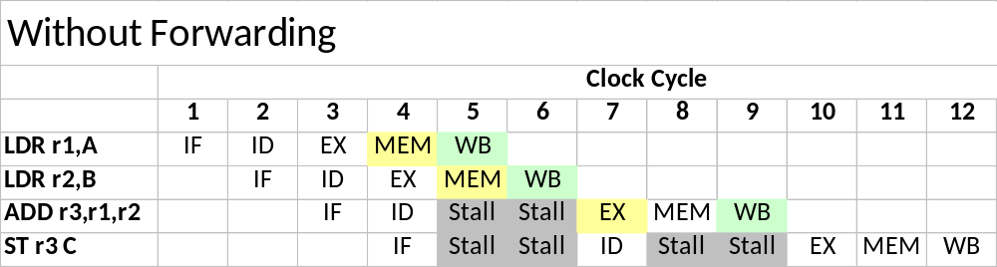
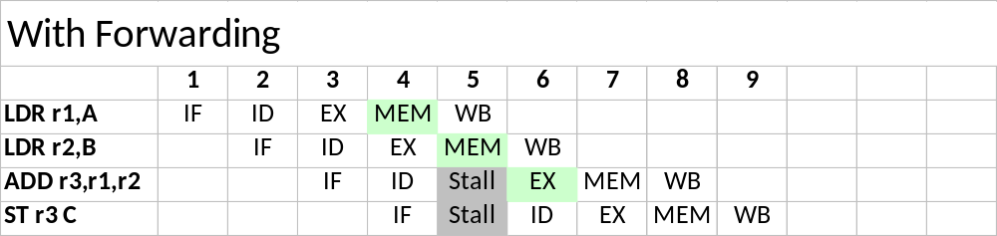
Forwarding Example

Slide 15
Deeper Pipelines
As mentioned previously we can go to longer pipelines
  Do less per pipeline stage
  Each step takes less time
  So clock frequency increases
But
  Greater penalty for hazards
  More likely to have conflicting instructions down the pipeline
  More complex control (e.g. forwarding lanes)
A trade-off between many aspects needs to be made
  Frequency, power, area,

Slide 16
Consider the following program which implements R = A^2 + B^2
  LD r1, A
  MUL r2, r1, r1 -- A^2
  LD r3, B
  MUL r4, r3, r3 -- B^2
  ADD r5, r2, r4 -- A^2 + B^2
  ST r5, R
Draw its dependency diagram
Simulate its execution in a basic 5-stage pipeline without forwarding.
Simulate the execution in a 5-stage pipeline with forwarding.

Slide 17
Where Next?
Despite these difficulties it is possible to build processors which approach 1 instruction per cycle (IPC)
Given that the computational model imposes sequential execution of instructions, can we do any better than this?

Slide 18
Instruction Level Parallelism
Superscalar processors

Slide 19
Instruction Level Parallelism (ILP)
Suppose we have an expression of the form
x = (a+b) * (c-d)
Assuming a,b,c & d are in registers, this might turn into
    ADD R0, R2, R3
    SUB R1, R4, R5
    MUL R0, R0, R1
    STR R0, x

Slide 20
ILP (cont)
The MUL has a dependence on the ADD and the SUB, and the STR has a dependence on the MUL
However, the ADD and SUB are independent
In theory, we could execute them in any order, or even in parallel
ADD R0, R2, R3
SUB R1, R4, R5
MUL R0, R0, R1
STR R0, x

Slide 21
The Dependency Graph a.k.a. Data Flow graph
We can see this more clearly if we plot it as a dependency graph (or data flow)
R2 R3 R4 R5
As long as R2, R3,
R4 & R5 are available,
We can execute the
ADD & SUB in parallel
ADD
SUB
MUL
x

Slide 22
Amount of ILP?
This is obviously a very simple example
However, real programs often have quite a few independent instructions which could be executed in parallel
Exact number is clearly program dependent but analysis has shown that 4 is relatively common (in parts of the program anyway)

Slide 23
How to Exploit?
We need to fetch multiple instructions per cycle – wider instruction fetch
Need to decode multiple instructions per cycle
Need multiple ALUs for execution
But must use common registers – they are logically the same registers
  Register bank needs more ports
But also access common data cache
  Data cache needs more ports

Slide 24
Dual Issue Pipeline
Two instructions can now execute in parallel
(Potentially) double the execution rate
Called a ‘Superscalar’ architecture (2-way)
Instruction
Cache
I1 I2
Register Bank
ALU
MUX
Data
Cache
PC
MUX
ALU

Slide 25
Register & Cache Access
Note the access rate to both registers & cache will be doubled
To cope with this we may need a dual ported register bank & dual ported caches
This can be done either by duplicating access circuitry or even duplicating whole register & cache structure

Slide 26
Selecting Instructions
To get the doubled performance out of this structure, we need to have independent instructions
We can have a ‘dispatch unit’ in the fetch stage which uses hardware to examine instruction dependencies and only issue two in parallel if they are independent

Slide 27
Instruction dependencies
If we had
  ADD R1,R1,R0
  MUL R2,R1,R1
  ADD R3,R4,R5
  MUL R6,R3,R3
Issued in pairs as above
Data dependencies will limit our opportunities for exploiting parallelism
ADD
MUL
ADD
MUL

Slide 28
Instruction reorder
If we examine dependencies and reorder
  ADD R1,R1,R0 ADD R1,R1,R0
  MUL R2,R1,R1 ADD R3,R4,R5
  ADD R3,R4,R5 MUL R2,R1,R1
  MUL R6,R3,R3 MUL R6,R3,R3
We can now execute pairs in parallel (assuming appropriate forwarding logic)
ADD
ADD
MUL
MUL

Slide 29
Example of 2-way Superscalar
Dependency Graph
R2 R3
R4 R5
_{ADD R0, R2, R3}
_{SUB R1, R4, R5}
_{MUL R0, R0, R1}
_{STR R0, x}
_{MUL R2, R3, R4}
_{STR R2, y}
_{ADD R0, R2, R3}
_{SUB R1, R4, R5}
_{MUL R0, R0, R1}
_{MUL R2, R3, R4}
_{STR R0, x}
_{STR R2, y}
ADD
SUB
R3 R4
MUL
MUL
STR
STR
x
y

Slide 30
2-way Superscalar Execution
Scalar Processor
 | 1 | 2 | 3 | 4 | 5 | 6 | 7 | 8 | 9 | 10
ADD R0, R2, R3 | IF | ID | EX | MEM | WB
SUB R1, R4, R5 |  | IF | ID | EX | MEM | WB
MUL R0, R0, R1 |  |  | IF | ID | EX | MEM | WB
MUL R2, R3, R4 |  |  |  | IF | ID | EX | MEM | WB
STR R0, x |  |  |  |  | IF | ID | EX | MEM | WB
STR R2, y |  |  |  |  |  | IF | ID | EX | MEM | WB
Superscalar Processor
 | 1 | 2 | 3 | 4 | 5 | 6 | 7
ADD R0, R2, R3 | IF | ID | EX | MEM | WB
SUB R1, R4, R5 | IF | ID | EX | MEM | WB
MUL R0, R0, R1 |  | IF | ID | EX | MEM | WB
MUL R2, R3, R4 |  | IF | ID | EX | MEM | WB
STR R0, x |  |  | IF | ID | EX | MEM | WB
STR R2, y |  |  | IF | ID | EX | MEM | WB

Slide 31
Limits of ILP
Modern processors are up to 4-way superscalar (but rarely achieve 4x speed)
Not much beyond this
  Hardware complexity
  Limited amounts of ILP in real programs
Limited ILP not surprising, conventional programs are written assuming a serial execution model

Slide 32
Consider the following program which implements R = A^2 + B^2 + C^2 + D^2
  LD r1, A
  MUL r2, r1, r1 -- A^2
  LD r3, B
  MUL r4, r3, r3 -- B^2
  ADD r11, r2, r4 -- A^2 + B^2
  LD r5, C
  MUL r6, r5, r5 -- C^2
  LD r7, D
  MUL r8, r7, r7 -- D^2
  ADD r12, r6, r8 -- C^2 + D^2
  ADD r21, r11, r12 -- A^2 + B^2 + C^2 + D^2
  ST r21, R
The current code is not really suitable for a superscalar pipeline because of its
low instruction-level parallelism
Reorder the instructions to exploit superscalar execution. Assume all kinds of forwarding are implemented.

Slide 33
Reordering Instructions

Slide 34
Compiler Optimisation
Reordering can be done by the compiler
If compiler can not manage to reorder the instructions, we still need hardware to avoid issuing conflicts (stall)
But if we could rely on the compiler, we could get rid of expensive checking logic
This is the principle of VLIW (Very Long Instruction Word)^{[1]}
Compiler must add NOPs if necessary
[1] You can find an introduction to VLIW architectures at:
https://web.archive.org/web/20110929113559/http://www.nxp.com/acrobat_download2/other/vliw-wp.pdf

Slide 35
Compiler limitations
There are arguments against relying on the compiler
  Legacy binaries – optimum code tied to a particular hardware configuration
  ‘Code Bloat’ in VLIW – useless NOPs
Instead, we can rely on hardware to re-order instructions if necessary
  Out-of-order processors
  Complex but effective

Slide 36
Out of Order Processors
An instruction buffer needs to be added to store all issued instructions
A dynamic scheduler is in charge of sending non-conflicted instructions to execute
Memory and register accesses need to be delayed until all older instructions are finished to comply with application semantics

Slide 37
Out of Order Execution
What changes in an out-of-order processor
  Instruction Dispatching and Scheduling
  Memory and register accesses deferred
PC
Instr.
Cache
Data
Cache
Schedule
Dispatch
Register Bank
Delay
Instruction
Buffer
ALU
Memory
Queue
Register
Queue
MUX
Delay

Slide 38
Consider a simple program with two nested loops as the following:
    while (true) {
    for (i=0; i<x; i++) {
    do_stuff
    }
    }
With the following assumptions:
  do_stuff has 20 instructions that can be executed ideally in the pipeline.
  The overhead for control hazards is 3-cycles, regardless of the branch
  being static or conditional.
  Each of the two loops can be translated into a single branch instruction.
Calculate the instructions-per-cycle that can be achieved for different values of x (2, 4, 10, 100):
  Without branch prediction.
  b) With a simple branch prediction policy - do the same as the last time.

